Slide 1
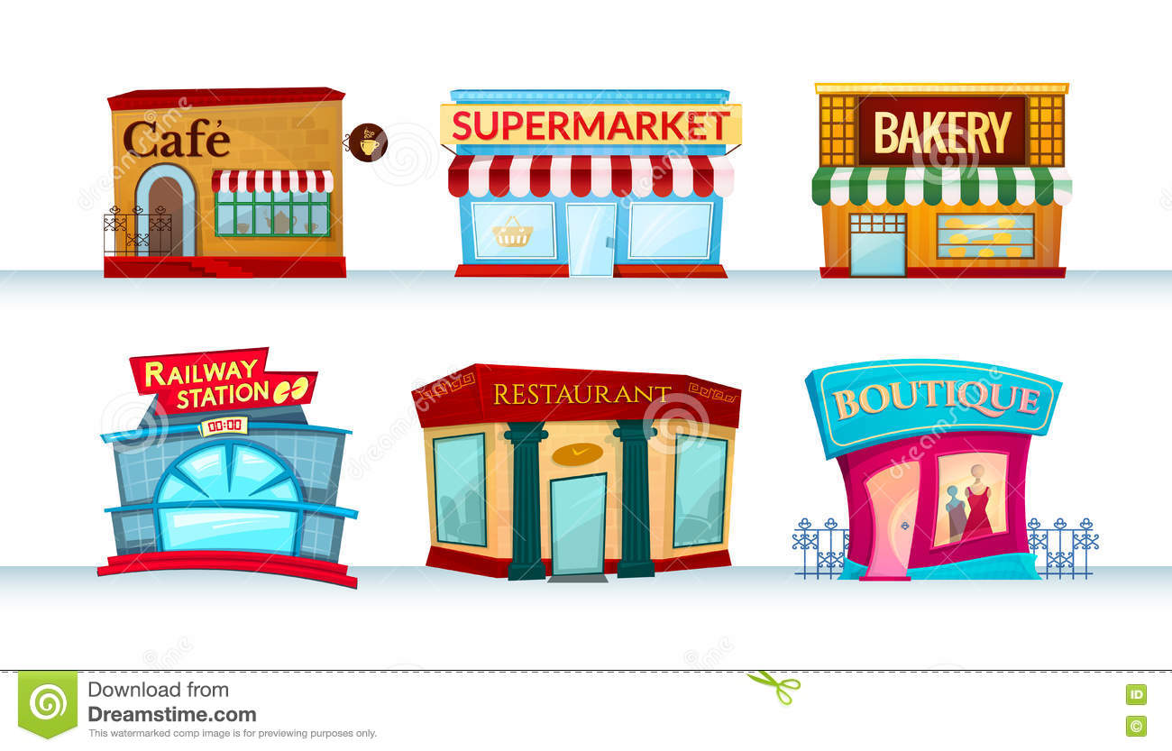
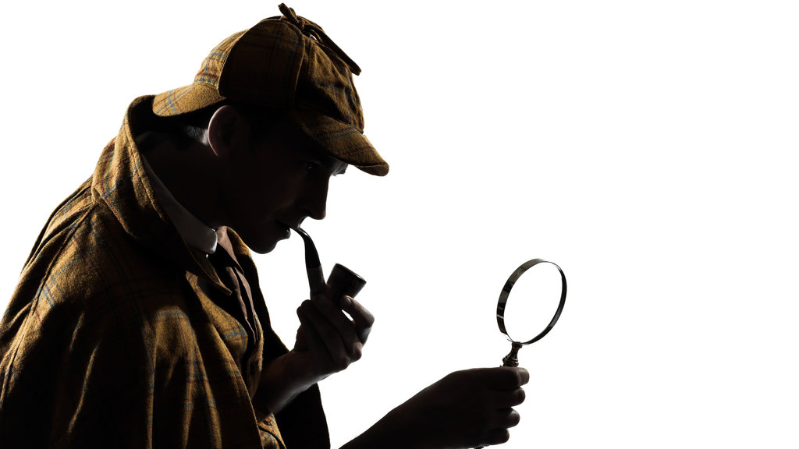
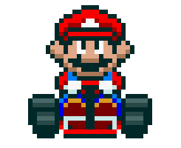
Were you at the supermarket yesterday?

Slide 2
at+小地方
定冠詞
指定某個地點
at the……
at home/school

Slide 3
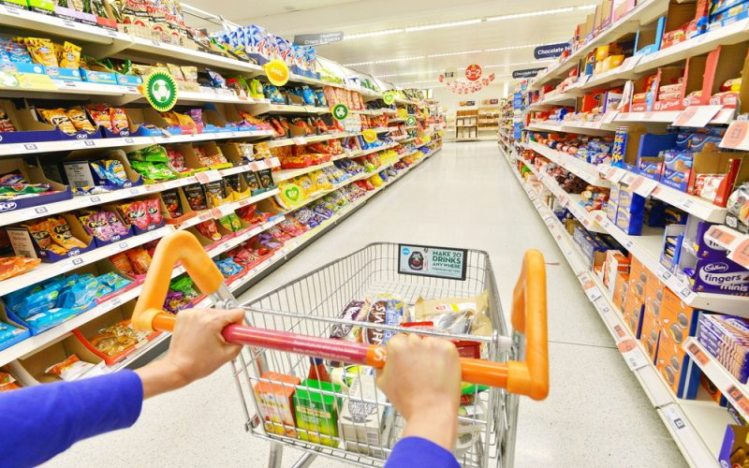
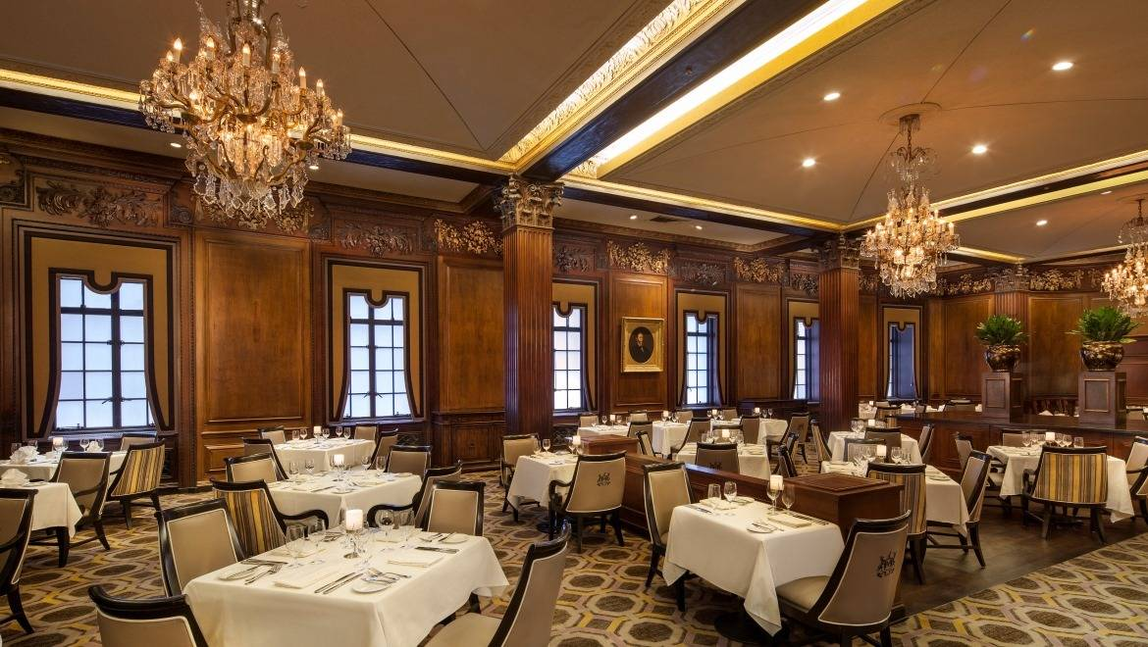
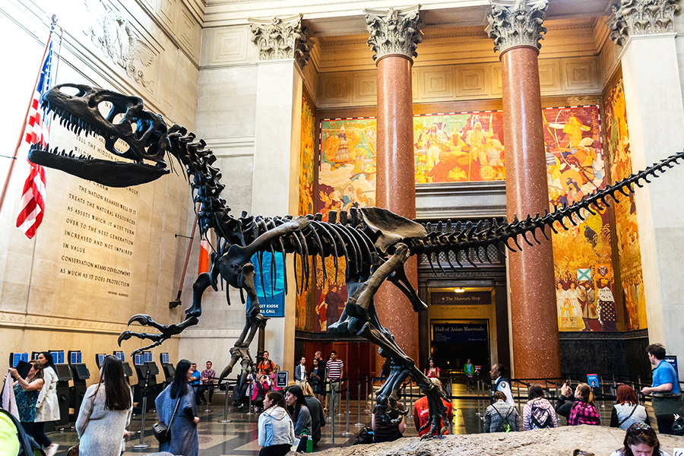
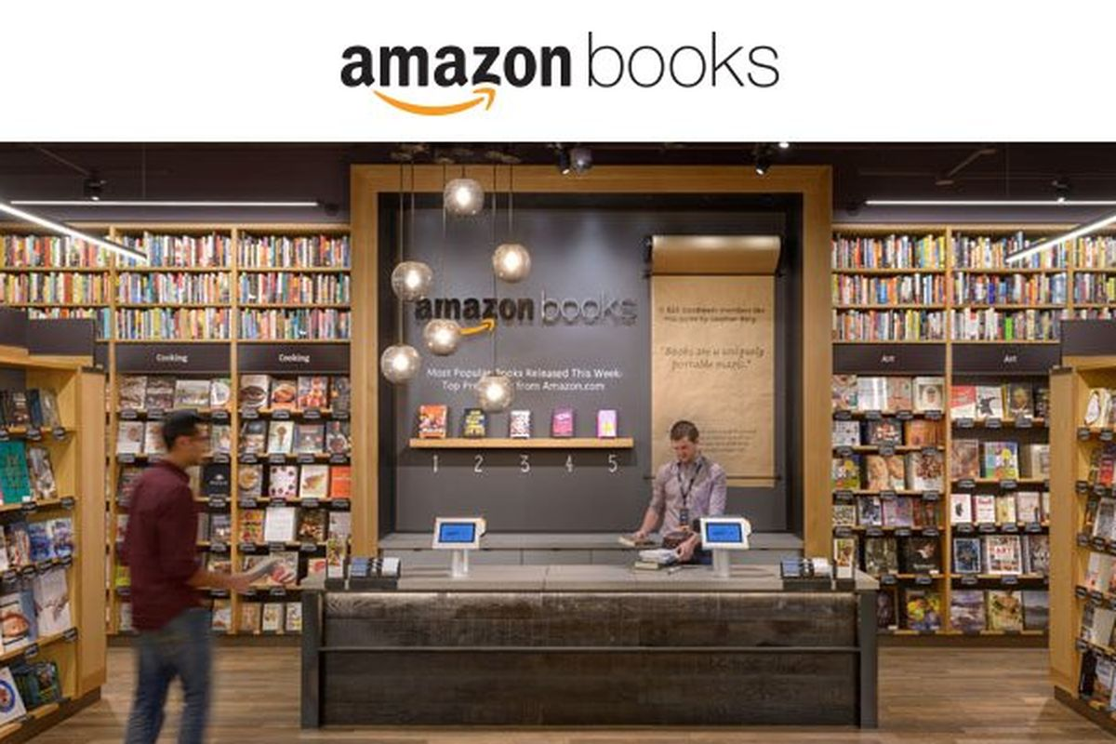
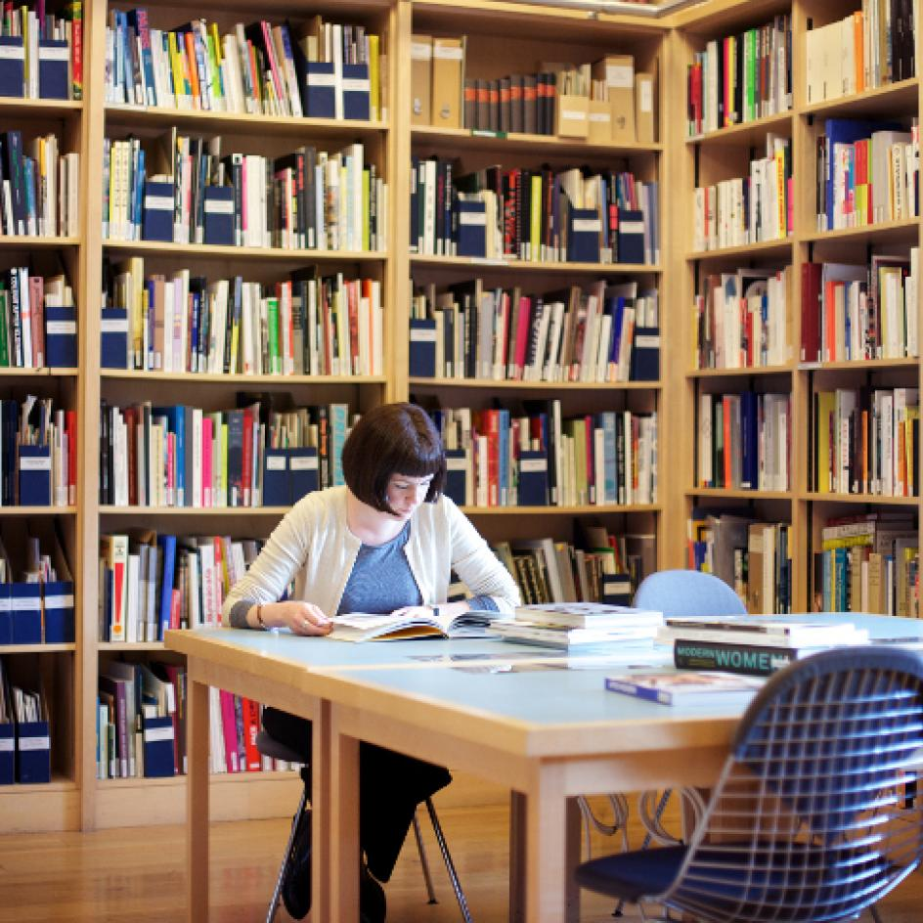
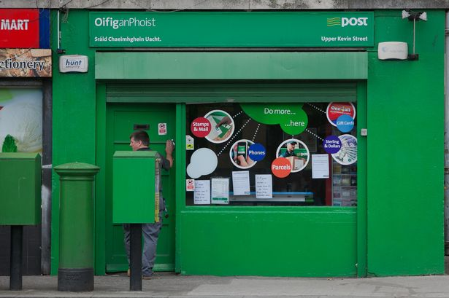
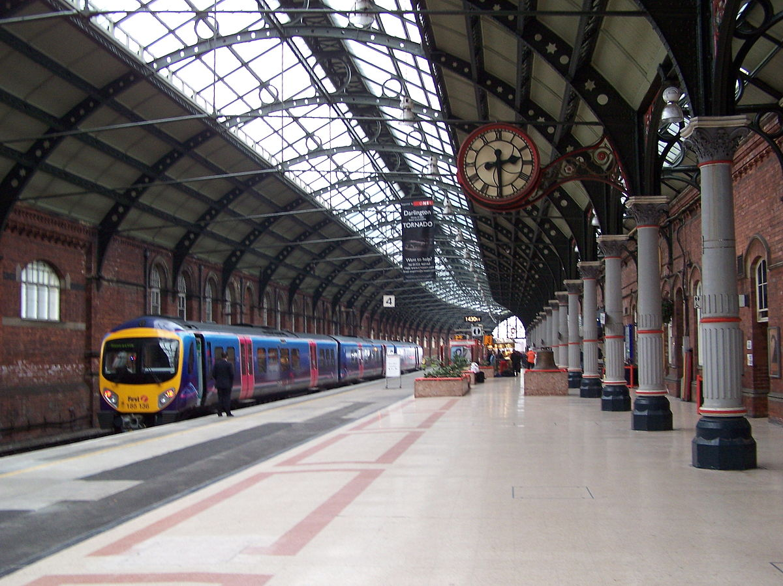
supermarket
3
museum
1
2
restaurant
4
hospital
post office
8
5
7
bookstore
6
library
train station

Slide 4
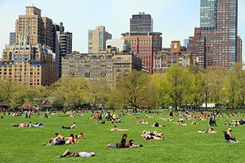
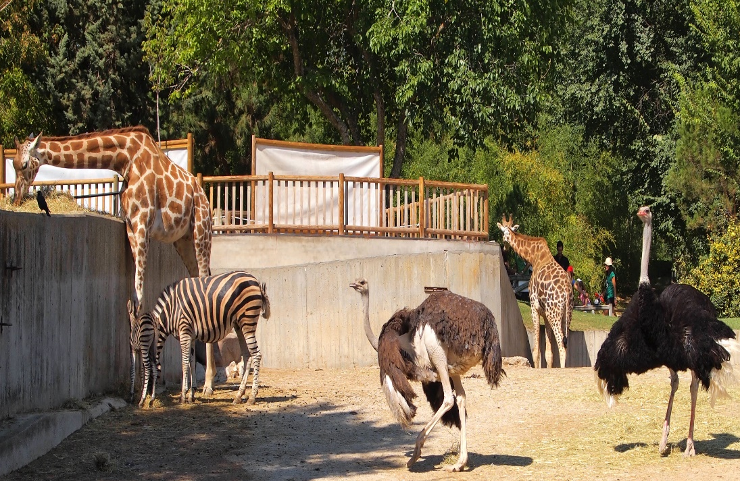
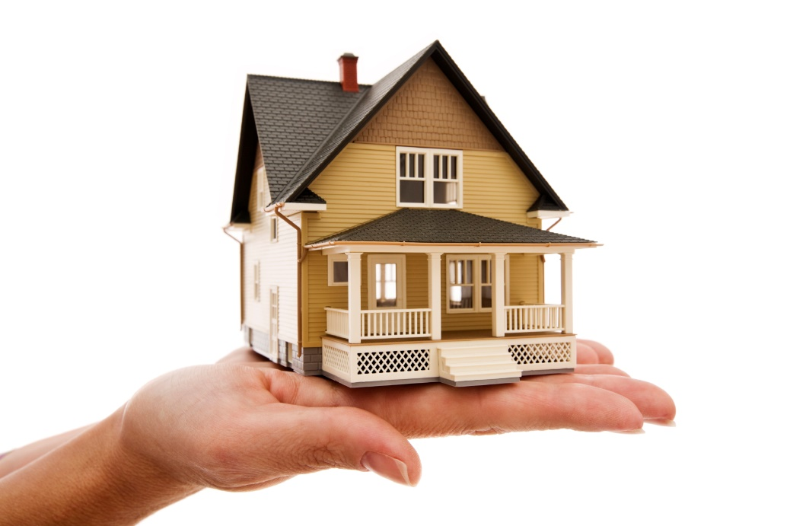
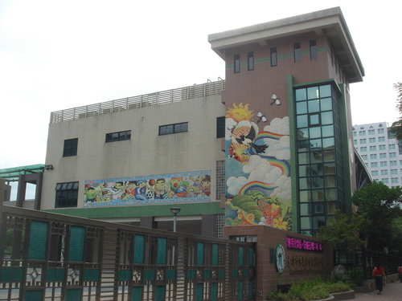
Review the words you learned before.
zoo
park
home
school

Slide 5
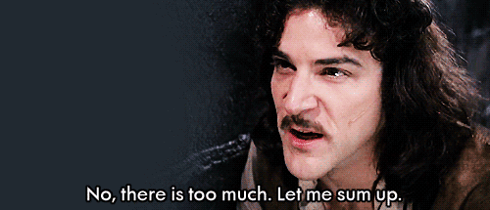
I 、He、She → was / wasn’t
We 、You、They → were / weren’t

Slide 6
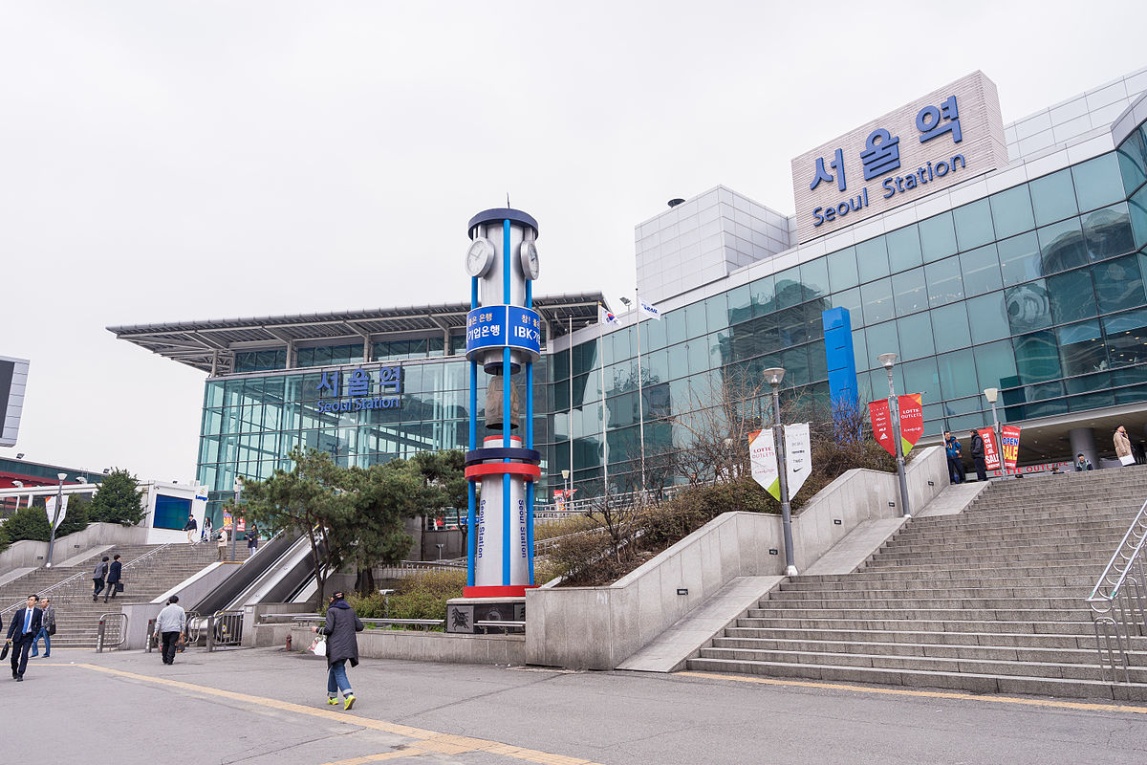
Q1: Was Tzu-Yu at the park yesterday?

Slide 7
No, she wasn’t. She was at the train station yesterday.

Slide 8
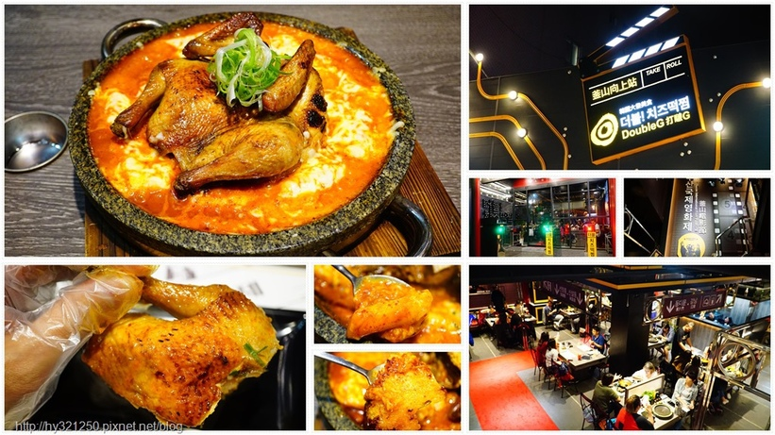
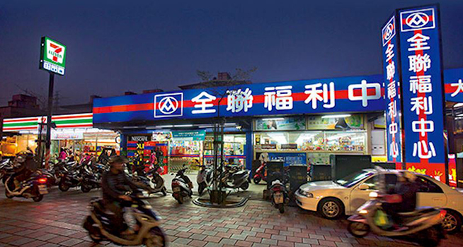
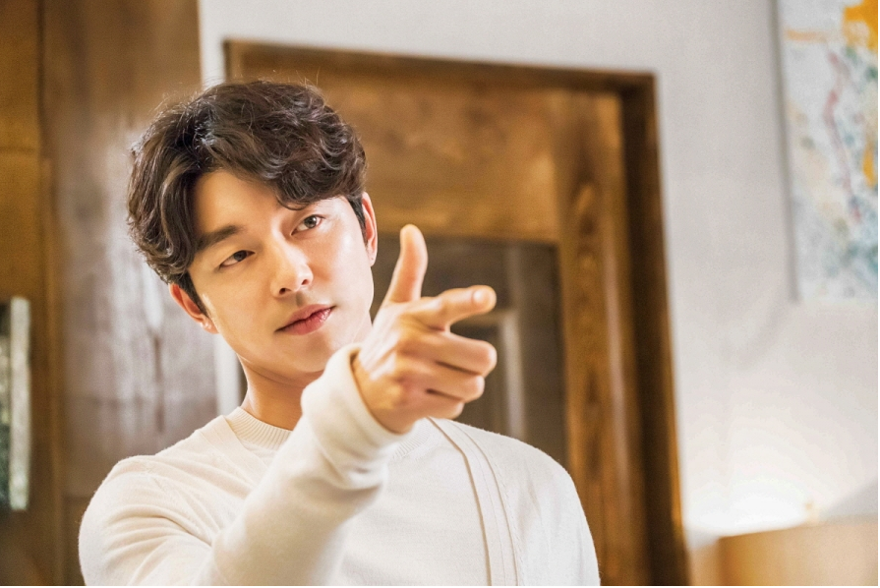
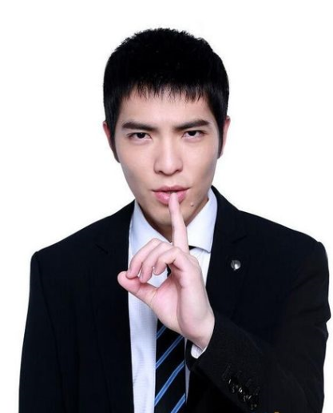
Q2: Was Gong Yoo at the restaurant yesterday?

Slide 9
Yes, he was. He was at the restaurant yesterday.

Slide 10
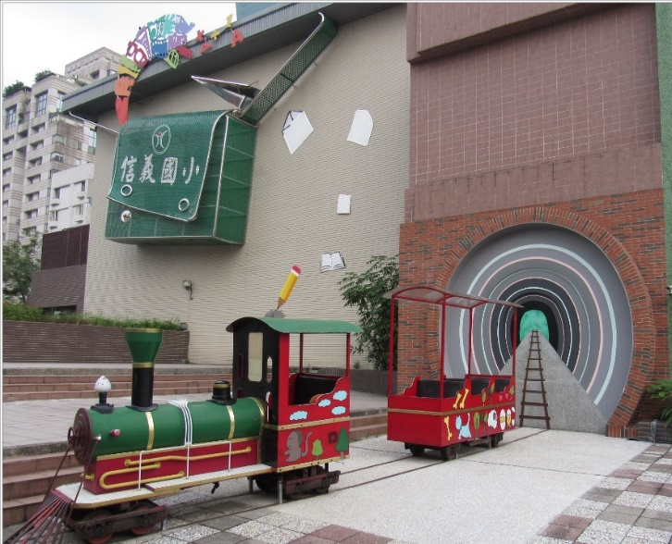
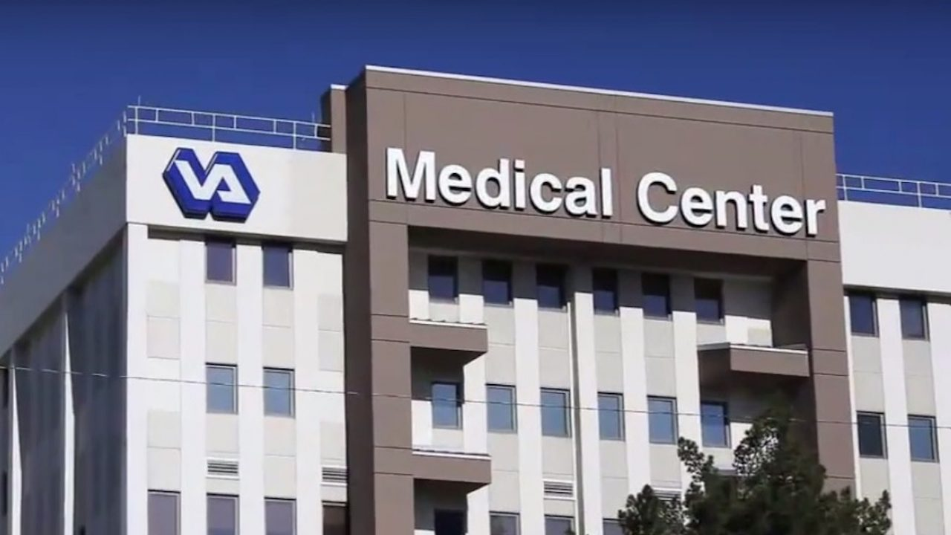
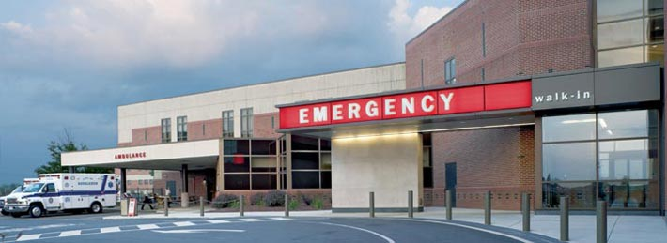
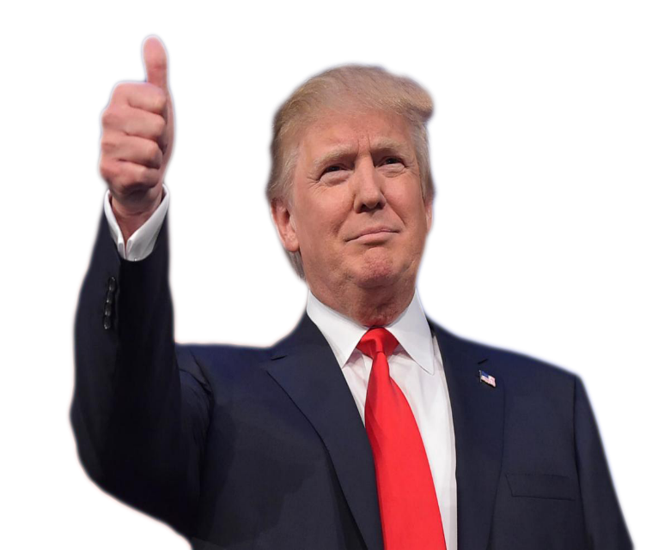
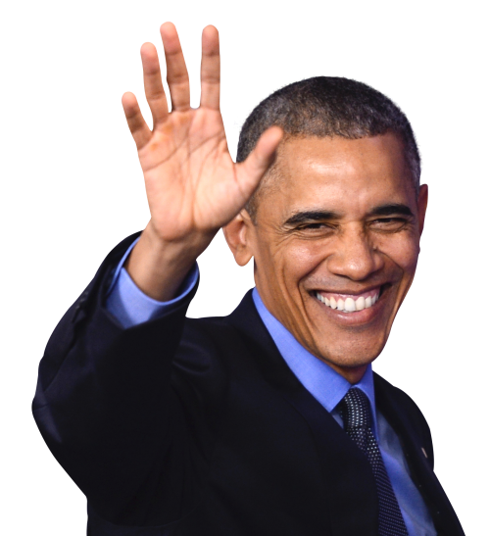
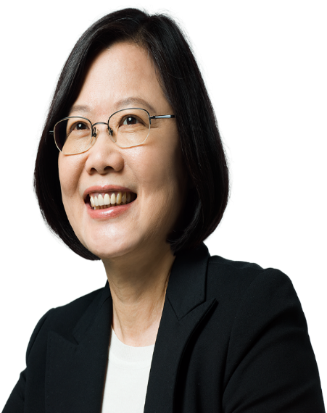
Q3: Were President Trump and President Tsai at the bookstore yesterday?

Slide 11
No, they weren’t. They were at the hospital yesterday.

Slide 12
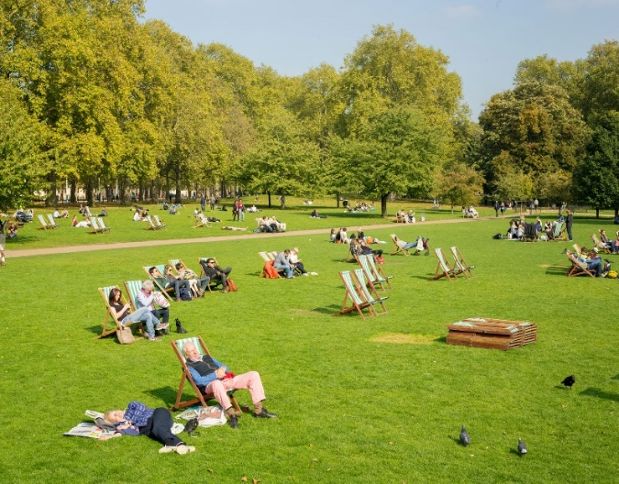
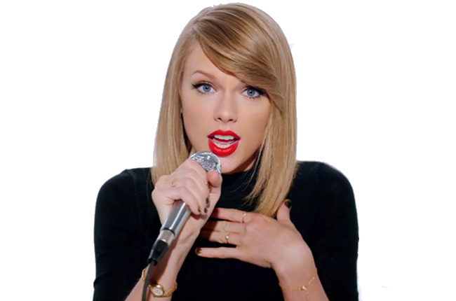
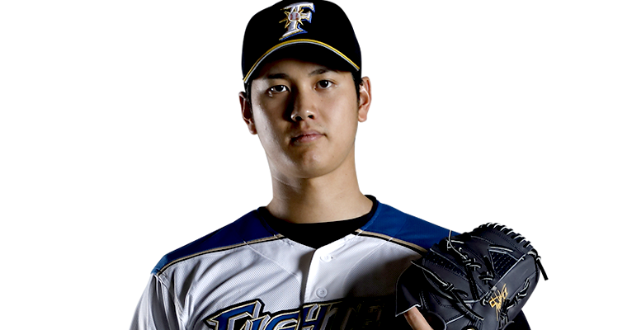
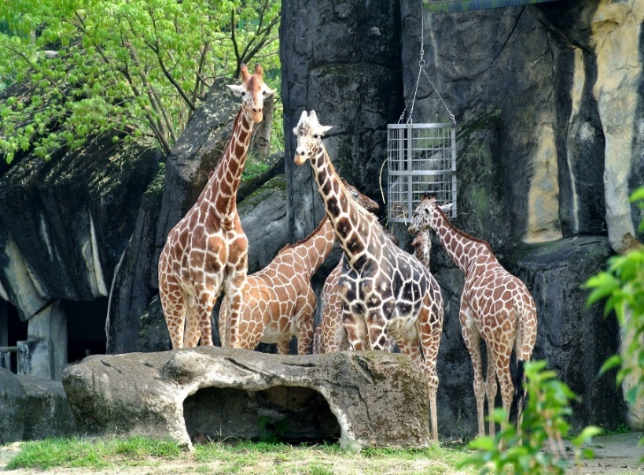
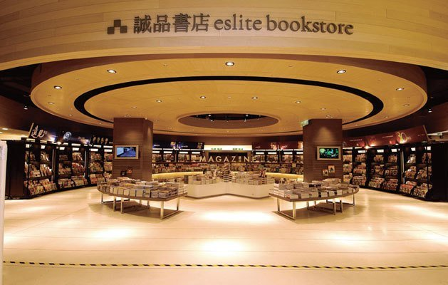
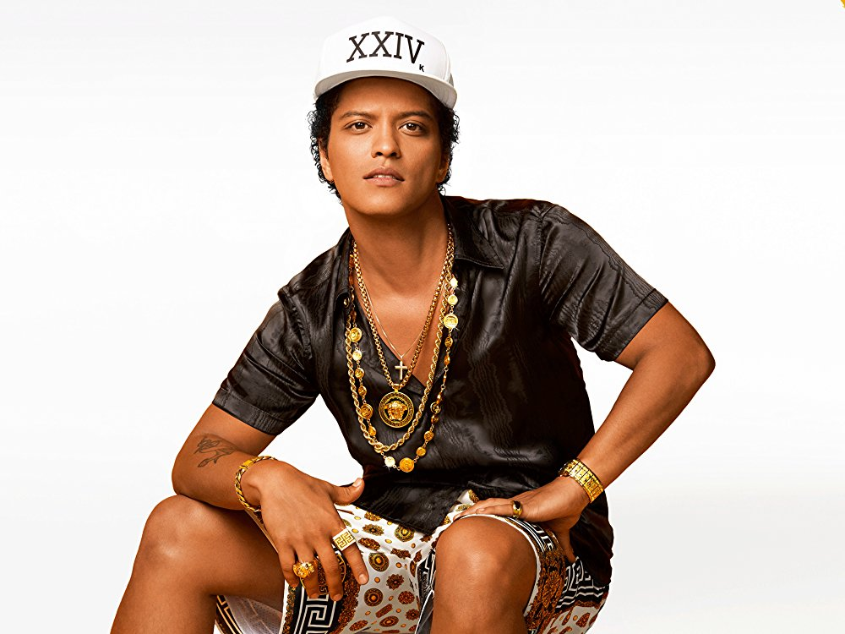
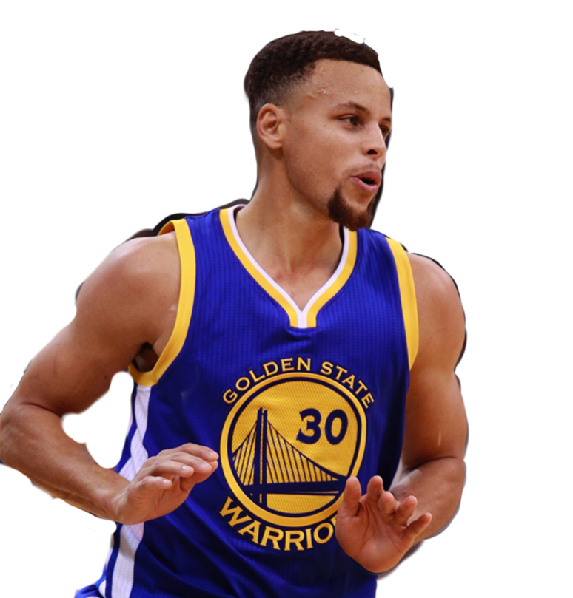
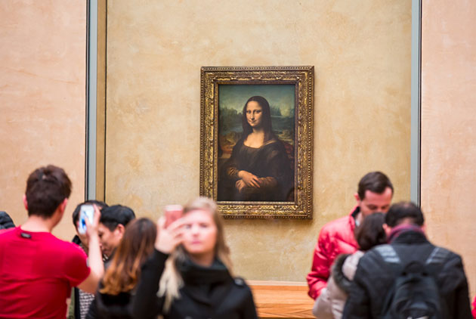
Q4: Was Stephan Curry at the park yesterday?
Ohtani Shohei

Slide 13
No, he wasn’t. He was at the bookstore yesterday.

Slide 14
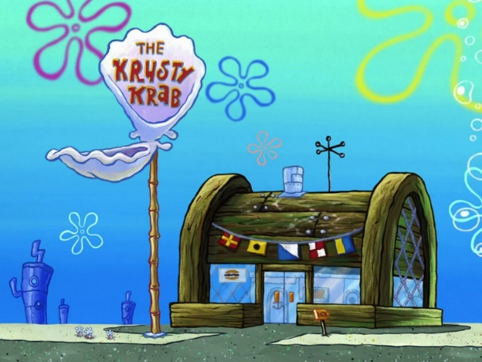
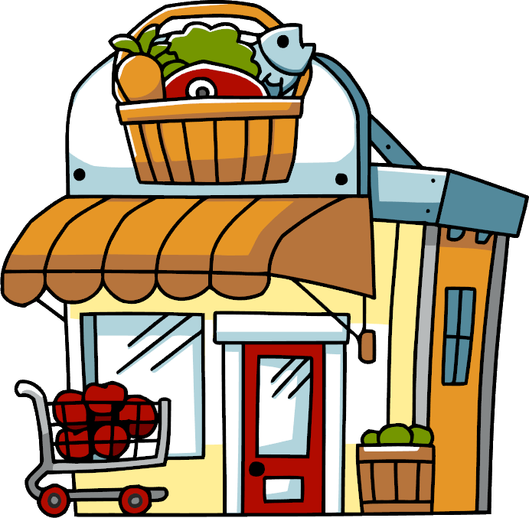
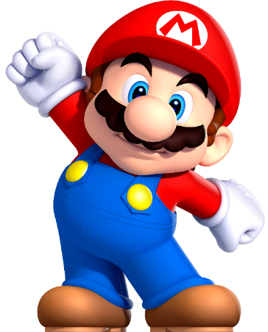
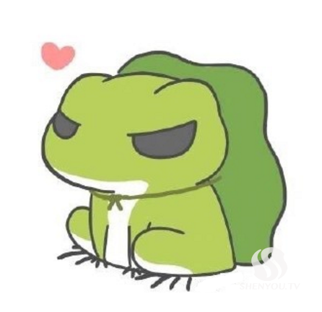
Q5: Was Conan at the restaurant yesterday?

Slide 15
No, he wasn’t. He was at home yesterday.

Slide 16
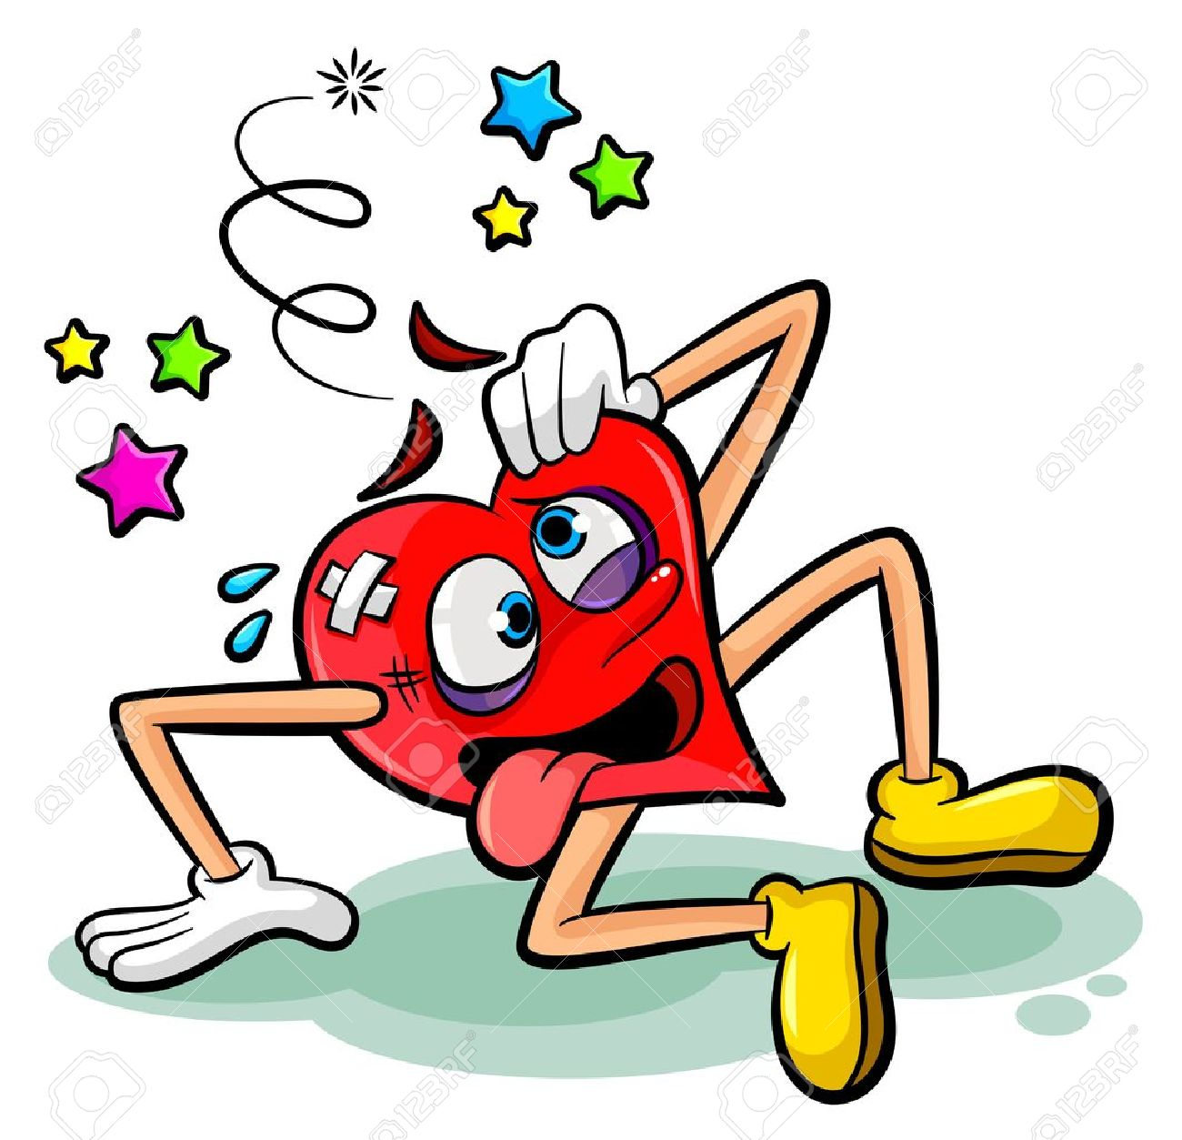
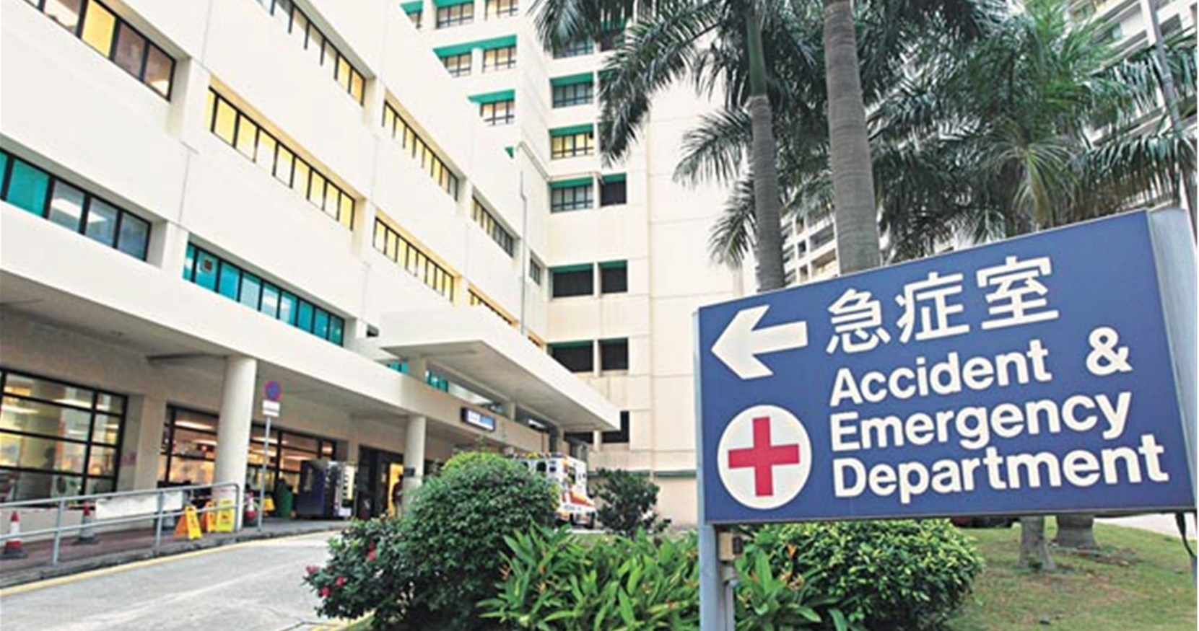
hospital
I (was/were) at the __________ yesterday.

Slide 17
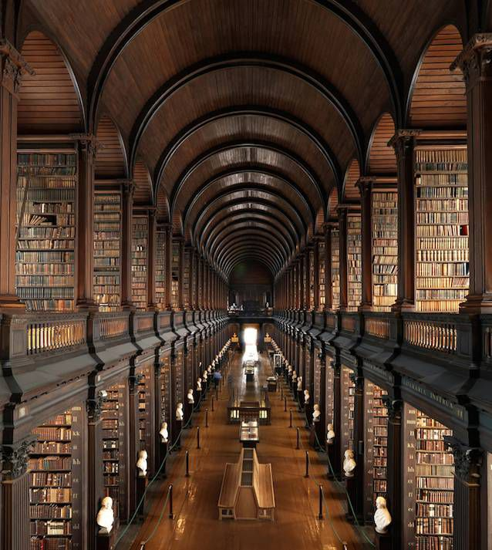
library
(Was/Were) you at the ________
last year?

Slide 18
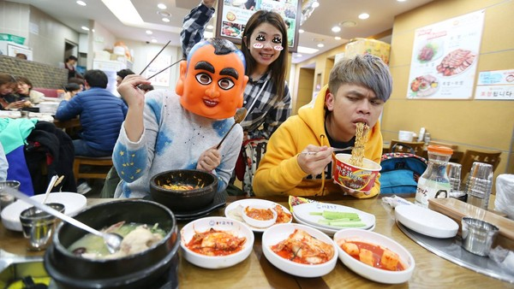
He (was/were) at the Korean __________ yesterday afternoon.
restaurant

Slide 19
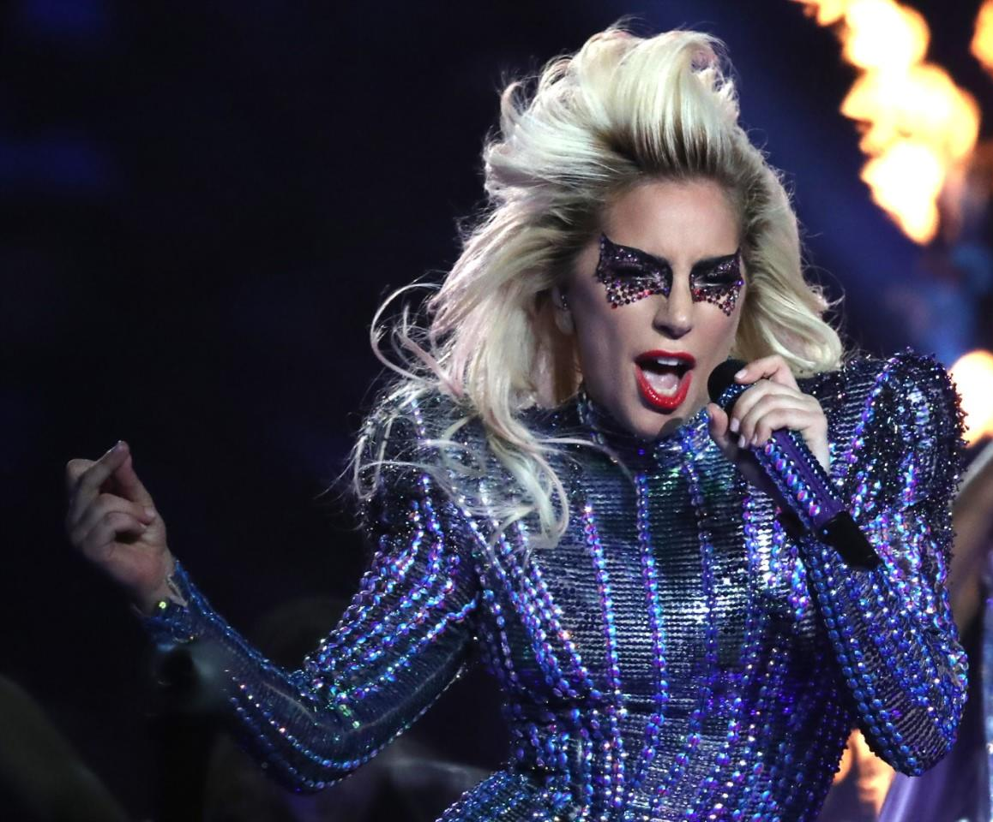
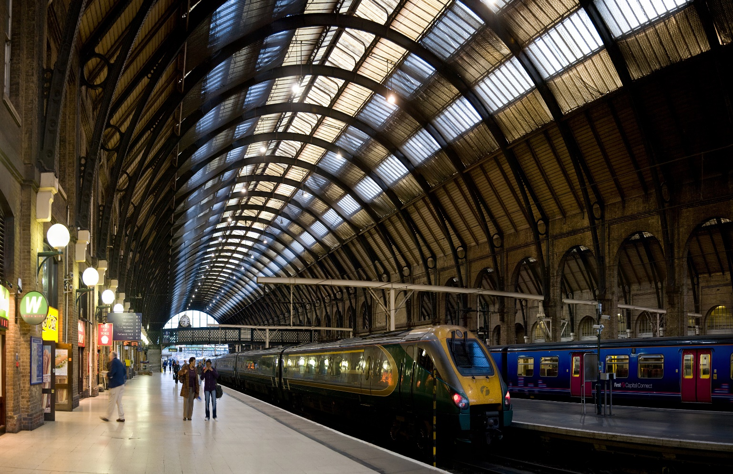
(Was/Were) Lady Gaga at the ___________ yesterday morning?
train station

Slide 20
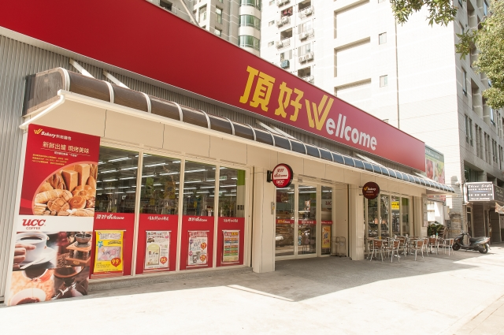
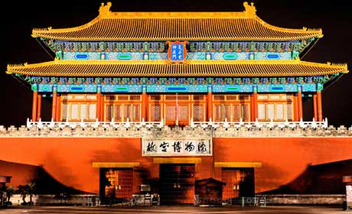
supermarket
They (was/were) at the ________ and the ________ last night.
museum

Slide 21
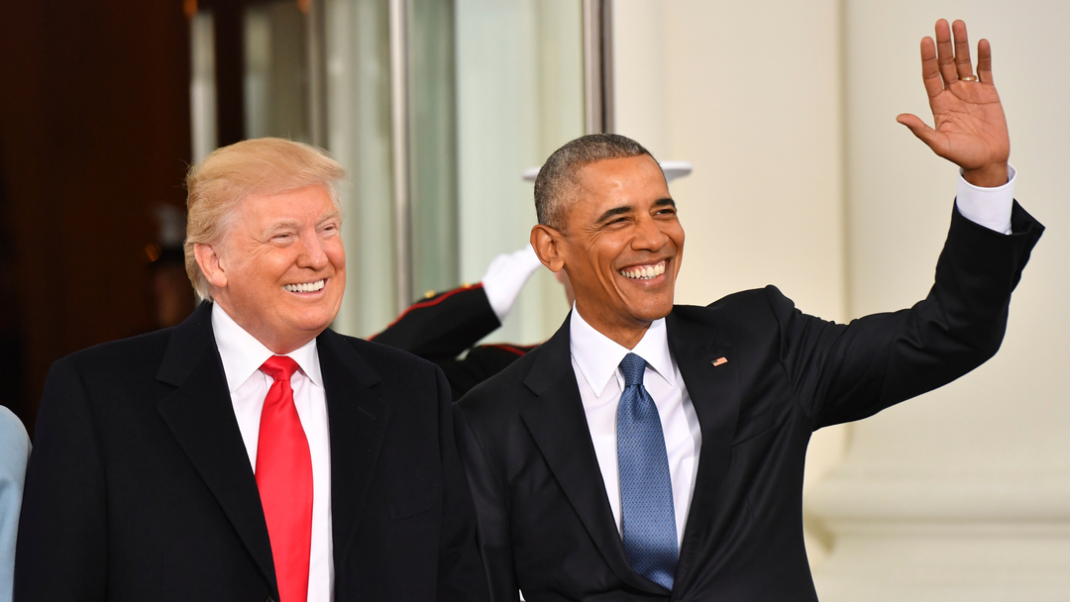
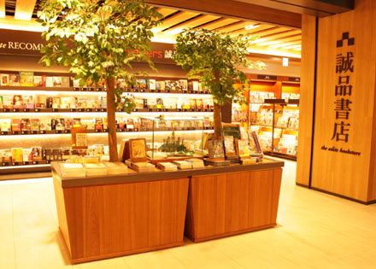
(Was/Were) Obama and Trump at the __________ two days ago?
bookstore

Slide 22
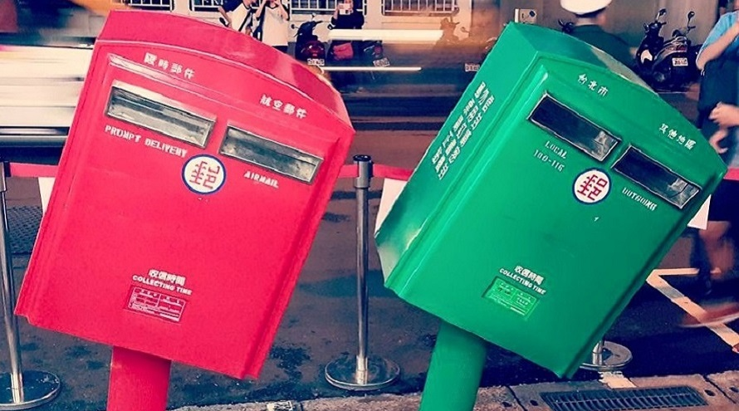
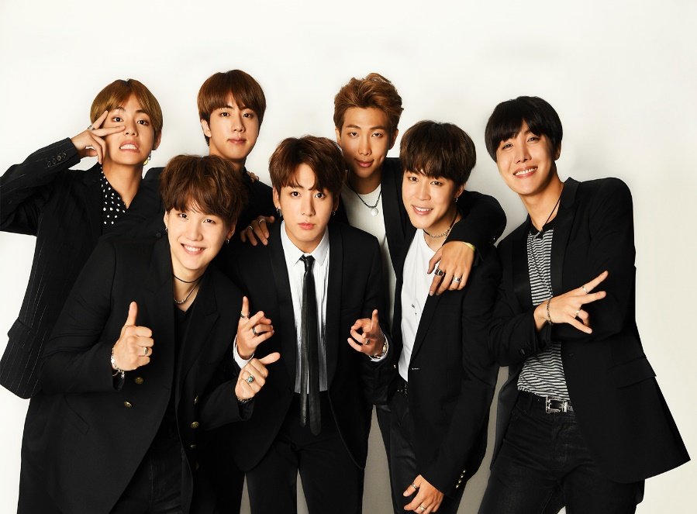
(Was/Were) TWICE and BTS at home last week?
No, they (wasn’t/weren’t).They (was/were) at the _____ last week.
post office

Slide 23
Ash
Mario

Slide 24
at / at the
George | at the zoo
Ash | at the park
Mario | at school

Slide 25
What are they doing?
What kinds of public places do you see?
Any other public places you know?

Slide 27
Story Time

Slide 28
Pensieve儲思盆: It’s an object used to review memories. It has the appearance of a shallow stone or metal basin

Slide 29
Circle out these words and phrases from Unit 2.

Slide 30
Find the answers together!

Slide 31
was
_____是am / is的過去式
_____是are的過去式
were

Slide 32
was/ wasn’t
I、He、She + _____
We、You、They+ _____
were/ weren’t

Slide 33
本課句型的組成:
人+過去式be動詞+地方+時間
句5: I was at the bookstore yesterday morning.

Slide 34
改疑問句:
Were you at the bookstore yesterday morning?

Slide 35
圈出對話裡的這些生字&片語並翻譯
map | 地圖
look for | 尋找
take a look | 看一下
then | 那時/當時
still | 仍然
maybe | 或許
can’t wait to… | 等不及要…
hurry | 趕快

Slide 36
課文中出現哪些表示過去的時間:
yesterday
2.yesterday morning
3.then
4.yesterday afternoon

Slide 37
wasn’t
was not = _______
were not = _________
weren’t

Slide 38
Is anybody home?
中文是:
home在這裡當_____詞，
意思是『在家的』。
有人在家嗎?
形容

Slide 39
1 → Air sound guessing
2 → Group 2/4/6 read
3 → Group 1/3/5 read
4 → Find mistakes
5 → Your group gets 1 point for free
6 →

